Slide 1
How to better manage your data – and thereby enrich research
Lecture in Scientific Writing and Presenting
15th January 2024
Published under CC-BY license
Notes:
A warm welcome to todays workshop. Me and my colleagues would like to introduce you to the National Research Data Infrastructure and Research Data Management, in Biodiversity and Environmental Science.

Slide 2
Introduction
Notes:
Lets start with a dive into the age of big data.

Slide 3

The age of ‘big data’
‘The rising tide of data – nearly as many digital bits as there are stars in the universe.’
Source: IDC’s Digital Universe Study 2014 https://www.emc.com/leadership/digital-universe/2014iview/executive-summary.html
Notes:
The term data does shape the 21st century like no other.
Data protection, digitalization, home office and so on, have drawn data into public.
The pandemic has further fueled this development enormously.
I would like to give you an idea of what it means to live in the age of 'Big Data'.

Slide 4
Availability of research data over time
Missing data
As research articles age, the odds of their raw data being extant drop dramatically.
Data being lost are estimated to increase by 17% in every year after publication.
Find a working e-mail address for the first, last, or corresponding author fell by 7% per year.
Overall, we only received 19.5% of the requested data sets, and only 11% for articles published before 2000.
Vines, Timothy H. et al. Current Biology, 2014, Volume 24, Issue 1, 94-97
Notes:
Here you can see a study by Vines and colleagues from 2014 who examined 516 ecological studies.
They found that published data are available very well within the first 2 years after publication, but after that time period it becomes more and more difficult to access the data.
After 10 years the chance to get research data belonging to a specific study decrease rapidly.
After 20 years the chance to get the data you are looking for is about 20%-30%.

Slide 5
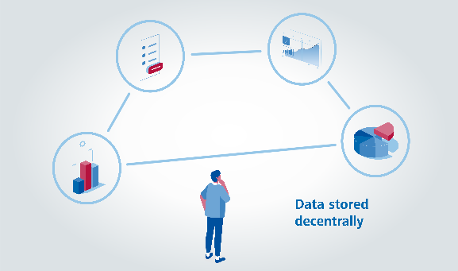
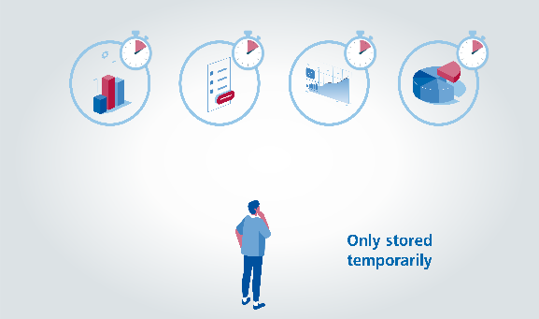
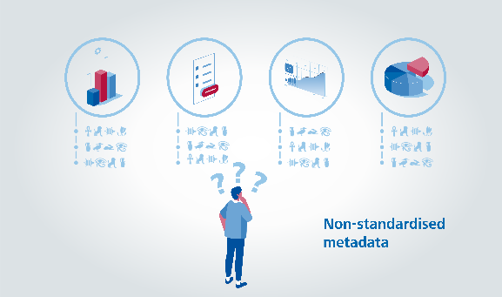
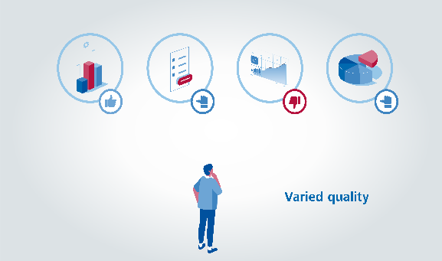
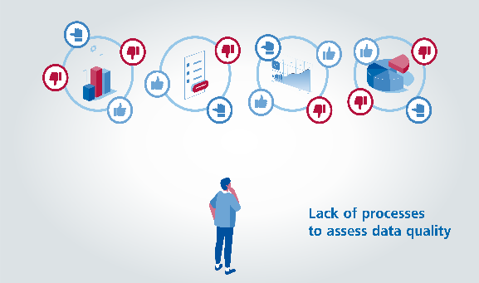
National research data landscape, Germany
Modified after https://www.dfg.de/foerderung/programme/nfdi/informationsmaterialien/index.html
Notes:
Research data are currently...
Stored decentrally, as institutions usually maintain their own specifications and platforms
Further they are often stored temporarily, due to limited server space at institutions
They are not described in a standardized way.
Further, data often vary in quality because there are no defined quality parameters or processes

Slide 6
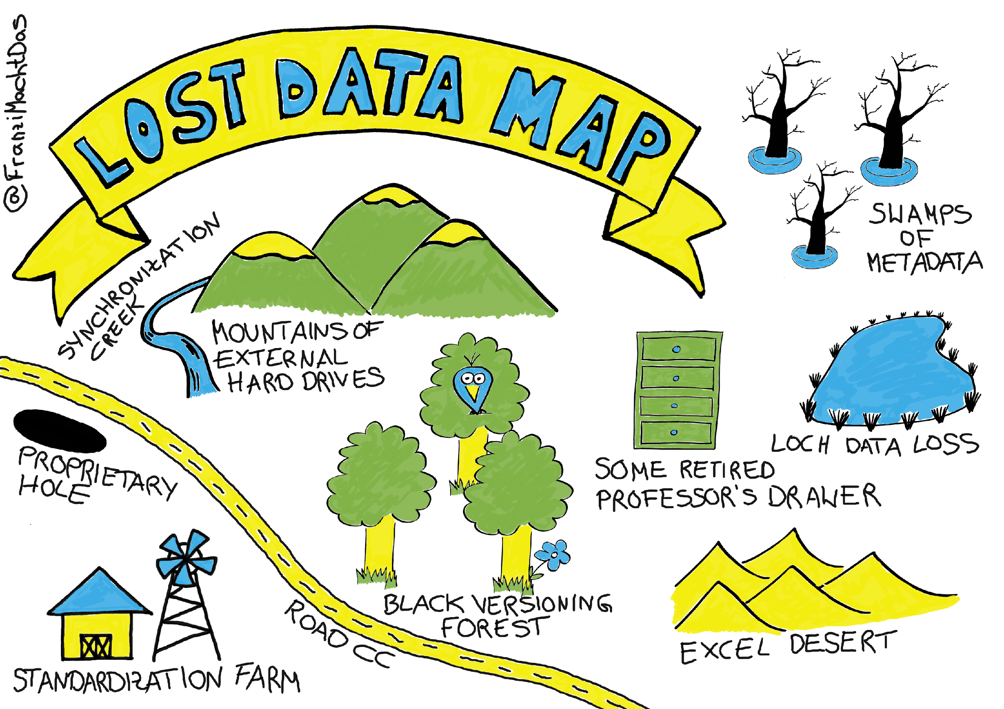
Good Scientific Practice?
Research Data Management (RDM) is a process that involves the active organization and maintenance of data throughout the research process.
RDM further contains the suitable archiving of research data at the project’s completion. Thus, it is an ongoing activity throughout the data lifecycle!
Notes:
And we can avoid a lot of these problems
And that is where Research Data Management comes into focus.
RDM is a process…

Slide 7
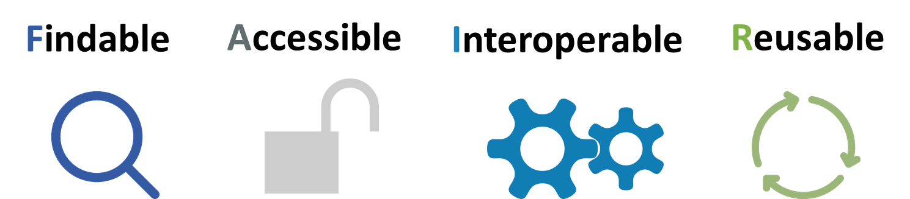
Data should be …
Data should be as open as possible as closed as necessary
RDM should be done according to these principles!
Notes:
We can avoid a lot of these problems if we make our data FAIR
That means they should be FINDABLE, ACCESSIBLE: INTEROPERABLE and REUSABLE
The Idea behind is that: Data should be as open as possible as closed as necessary
The FAIR data principles are one of the most important concepts in RDM… they were launched in 2014 with the intention to provide a set of guiding principles on how to handle data.
They found their way into many guidelines of funders (DFG, Horizon 2020), publishers and institutional policies.
RDM should be done according to these principles!
Today we will talk about, how you can achieve that.

Slide 8
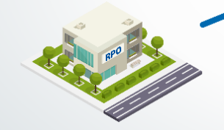
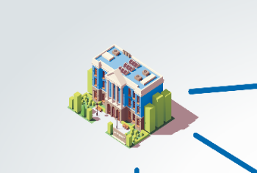

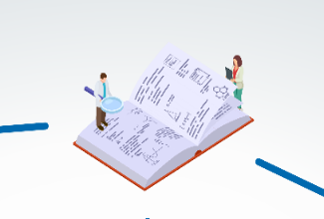
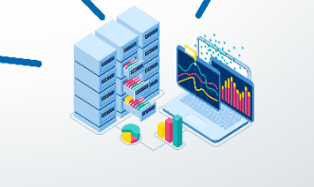
National research data landscape
Research Performing Organisations
Universities
Federal initiatives, Infrastructures & Professional societies
NFDI
Repositories
Disciplin-specific services
Modified after https://www.dfg.de/foerderung/programme/nfdi/informationsmaterialien/index.html
Notes:
In order to implement the FAIR data principles, one of the largest DFG projects launched by scientists for scientists... the National Research Data Infrastructure.

Slide 9
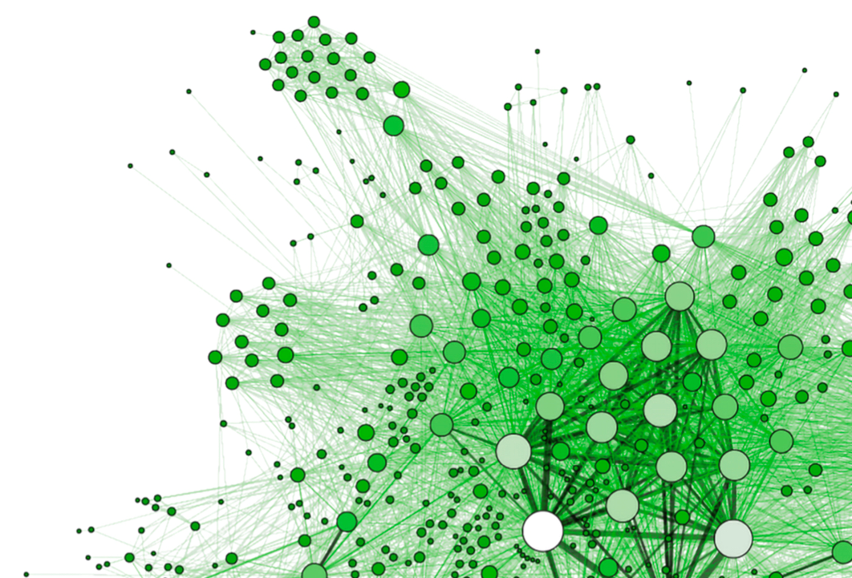
Structure of the NFDI
NFDI e.V. Association - Directorate -
Data Plant | GHGA | NFDI4Biodiversity | NFDI4Cat | NFDI4Chem
NFDI4Culture | NFDI4Health | NFDI4Ing | KonsortSWD | BERD@NFDI
DAPHNE4NFDI | FAIRmat | MaRDI | NFDI4DataScience | NFDI4Earth
NFDI4Microbiota | NFDI4MatWerk | PUNCH4NFDI | Text+ | NFDI4Memory
NFDI4Objects | NFDI4BIOIMAGE | NFDI4Energy | NFDI4Immuno | FAIRAgro
NFDIxCS | Base4NFDI
In 2023
27 Consortia
> 200 member organisations
www.nfdi.de
Notes:
The NFDI is a network of consortia that cooperate closely with each other to form an overarching infrastructure. It was Founded in November 2018, and is funded by a time period of 10 years with annual funding of up to €90 million. There are 27 consortia with over 200 organizations and more than 400 other partners.
Each of these consortia has their own research domain such as NFDI4Biodiversity, NFDI4Health, NFDI4Energy and so on.

Slide 10

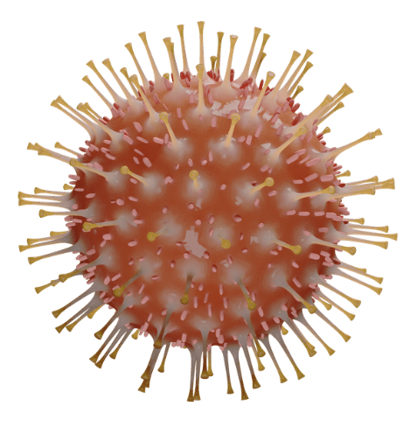




The COVID-19 Pandemic
The corona pandemic affected diverse aspects of human life.
Decision-makers did strongly depend on reliable data.
Notes:
The pandemic is a good example on how that works:
The corona virus is first a biodiversity problem and as it is a mutated virus but it is of course also a health problem and, as it affected diverse aspects of human life, also a topic for social science and finally strongly related to environmental issues as well.
The consortia work together and share their ressources in order to deliver reliable data for decision-makers and scientists.
In terms of covid-19, the benefits was clear: the better use of data through digital technologies and artificial intelligence (AI) were used to create an open science platform in order to develop the Covid 19 vaccine. Thus, the time to develop the vaccine was shortened by a factor of 10. What would otherwise has taken around ten years was done in one year.

Slide 11
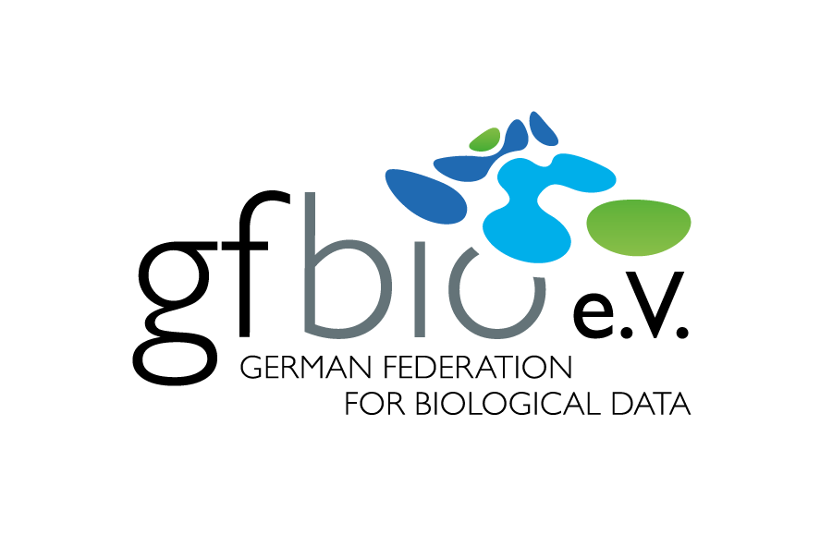



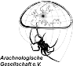









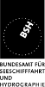

































Mission Statement
Stakeholders from science, politics and nature conservation need reliable data in order to be able to develop better contributions to the conservation of global biodiversity.
In our partner network, we work to make diverse and high-quality biodiversity data available.
Notes:
As you have seen, NFDI4Bio is a consortium with about 50 partner institutions from universities to research performing organisations and so on. Data Management is not only the task of the NFDI. Its up to the institutions themselves, for instance in terms of hiring data stewards and data scientists.

Slide 12



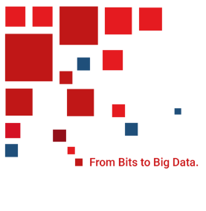
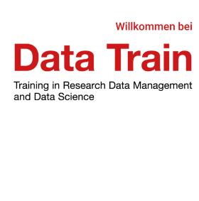
Jobs in RDM
Data Steward
Data Handling
Data Scientist Data Analysis
Raw Data
FAIR Data
Knowledge
Programming
Data Management
Software & IT Tools
Mathematics & Statistics
Domain Expertise
Computer Science
‘[…] the cross-discipline training program “Data Train” of the “U Bremen Research Alliance” teaches competencies in data literacy, research data management, and data science for doctoral researchers.[…]’
Notes:
Data stewards take care of the data handling and ensure that data are FAIR and can be analyzed by data scientists who will finally generate knowledge from these data.
This is a job market that is growing enormously and a good job opportunity for you as well. How does one become a data steward or data scientist? The University of Bremen, for example, offers a program called Data Train that is mainly aimed at PhD students, but it is also open to anyone who is interested Especially the basic lectures are accessible. If you are interested you can join the current program starting on the 17th of January. You can find information on the Data Train homepage.

Slide 13
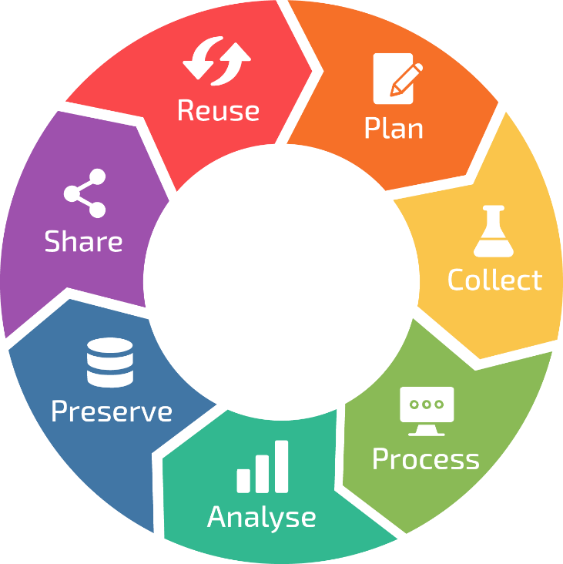
ELIXIR (2021) Research Data Management Kit. A deliverable from the EU-funded ELIXIR-CONVERGE project (grant agreement 871075). URL: https://rdmkit.elixir-europe.org
Notes:
Now, you have your data and it starts to get interesting as you know want to answer your research question.

